Slide 1
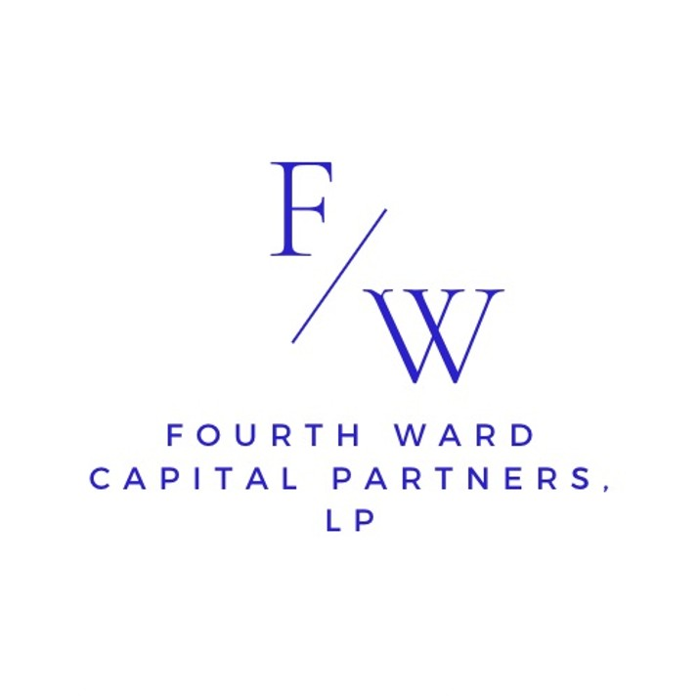
817 W Peachtree ST NW
Atlanta, GA 30308
917-709-9663
August 2026

Slide 2
Fourth Ward Investments Overview
Who We Are
Objective
Fourth Ward Investments, L.P. commenced operations on January 1, 2024, as a private investment partnership for U.S. investors.
We are an Atlanta based fund allowing us to take advantage of this growing financial services and technology center. We remain independent of the Wall Street “noise”.
To achieve superior investment returns, while preserving capital, by investing in a concentrated, limited number of equity securities domiciled in the U.S.
To balance the portfolio with a smaller percentage of less concentrated short positions, also primarily in the U.S.

Slide 3
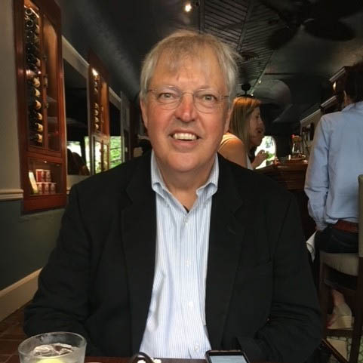
Meet the Principals
Michael is the chief architect of Fourth Ward’s investment strategy and brings a long track record of success. He was the co-founder of Seminole Management Co, Inc., a long-short equity hedge fund. As the Chief Investment Officer Mike successfully steered Seminole through both bull and bear markets, focusing on capital preservation during downturns. Since inception through August 2019, Seminole had gross annualized returns of 19.5% before fees, including a +1.8% gross return in 2008 when the S&P 500 was down 37%. He led Seminole to positive returns in 21 out of 23 years. Seminole peak assets totaled over $3 billion.

Slide 4
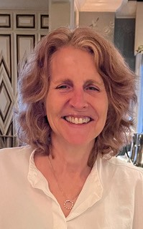
Meet the Principals
Beth Reynolds is a seasoned financial services professional with 30+ years of analytical and portfolio management experience.
Early in Beth’s career she was at Moody’s Investors Service where she rated housing and student loan debt. In 2000, Beth joined Seminole Capital, a long - short hedge fund, under the leadership of Mike Messner, where she was until 2019. There she held numerous roles including Chief Compliance Officer and ending her career there as Portfolio Manager. Post Seminole Capital in 2018, Beth has supported Mike Messner with his teaching at the Scheller School of Business.

Slide 5
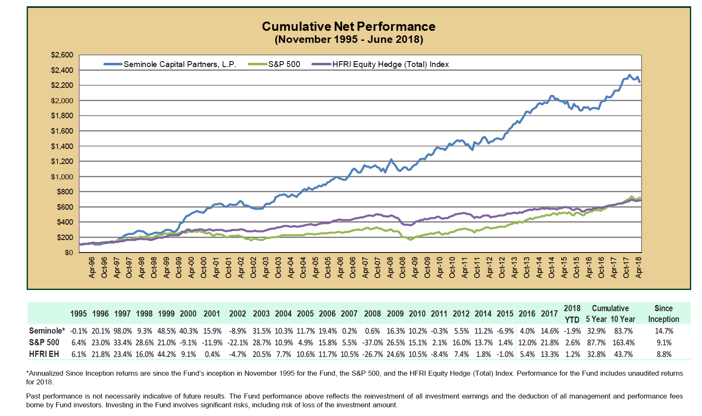
Our Performance - Seminole

Slide 6
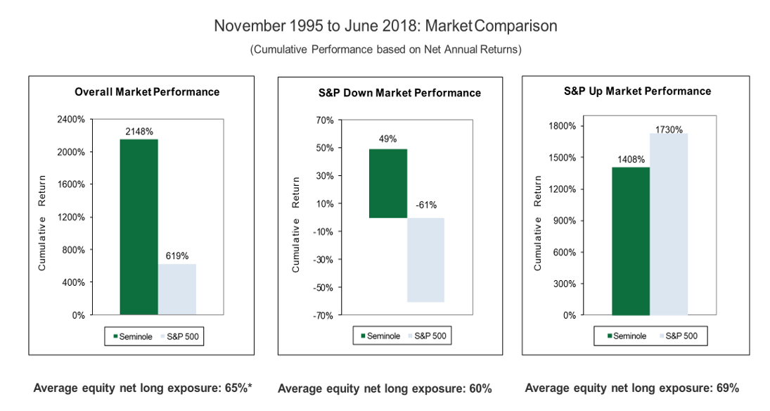
Up/Down Capture – Seminole Capital Partners, L.P.

Slide 7





Fund Incubation & Platform Build Out
2024
2025
2026
People, Process, & Research Framework
Investment team alignment, research process codified, modeling standards and risk controls implemented.
Capital Raising Phase Initiated
Platform fully built and validates, with capital raising now underway.
Structure Establishment
Formation of legal entities, offering documents, subscription materials and governance structure.
Operational Infrastructure
Prime brokerage relationships established, brokerage accounts opened, and operational workflows implemented.
Systems & Transparency Bulit
Real-time position tracking, performance reporting, and risk monitoring systems developed and tested.

Slide 8
Investment Process
DCF Analysis
Model
Utilize AI tools to accelerate data analysis, identify patterns, and support idea generation across financials, industry dynamics, and company-specific information.
Screen for quality businesses with strong free cash flow and durable competitive dynamics.
Build a 5+ year financial model based on history, management guidance, and industry trends.
Assess future capital allocation: dividends, buybacks, deleveraging, and acquisitions.
Estimate year 5 EPS and an exit multiple.
Calculate intrinsic value using equity risk premium, risk-free rate, and beta.
Screen Stocks & AI Research Tools
Earnings & News
Intrinsic Value
Allocation

Slide 9





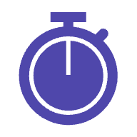
Risk Management
Discipline
Short Risk Control
Exposure Management
Structural Constraints
Liquidity Filters
Real-Time Oversight
Our risk framework combines strict sell discipline, diversified short exposure, and continuous monitoring of long/short balances to help control volatility. We operate with no leverage, apply liquidity-based trading constraints and avoid new issues to maintain efficient execution, and rely on real-time position reporting to track performance, risk, and individual holdings with precision.

Slide 10
Fourth Ward Hedge Fund: Terms & Structure
Fund Structure | Delaware Limited Partnership
Minimum Investment | $200,000 (may be waved at GP discretion)
Currency | USD
Subscriptions | Additional capital contributions permitted on the first day of each month with GP consent
Redemptions | Allowed as of March 31, September 30, December 31 with 60 days’ notice. GP may allow withdrawals at other times.
Special Withdrawal Rights | Available upon Key Person Event (if either Manager is no longer actively involved)
Management Fees | 1.00% per annum (0.25% quarterly), calculated on each LP capital account
Performance Fees | 15% of Net Profits, subject to high-water mark; no incentive allocation until prior losses are recovered
Investor Qualification | Must be an Accredited Investor under regulation D. Must also have sufficient financial sophistication and ability to bear risk
Reports to Investors | Monthly statements and quarterly letters; annual audited financials
Prime Broker / Custodian | Interactive Brokers LLC (and others at GP discretion)
Auditor | KPMG
Administrator | Integrated Solutions

Slide 11
Investment Summary
1
Consistently Pursuing Superior Returns. Fourth Ward seeks to generate steady excess returns through disciplined fundamental research, rigorous valuation work, and a concentrated, high-conviction portfolio.
2
Proven Experience & Investment Judgement. Our principals bring years of public-equity investing experience, applying seasoned judgement to security selection, risk assessment, and portfolio construction.
3
Transparency. Investors receive clear, data-driven insight into portfolio construction, valuation assumptions, risk exposure, and decision-making, ensuring alignment and trust.
Fourth Ward Capital Partners offers accredited investors a disciplined, valuation-focused equity strategy aimed at long-term compounding with a strong emphasis on downside protection and capital preservation.

Slide 12
Contact Information
General Inquiries
breynolds@fourthwardllc.com
Subscription Support
mforte@seminolecapital.com
Principals
mmessner@fourthwardllc.com
breynolds@fourthwardllc.com

Slide 13
Disclaimer
This presentation is for informational purposes only and does not constitute an offer to sell or a solicitation of an offer to buy interests in Fourth Ward Capital Partners, L.P. Any such offer or solicitation will be made only to qualified investors pursuant to the Fund’s confidential offering memorandum and subscription documents, which should be reviewed carefully before investing. The information herein is summary in nature, is not complete, and is subject to change without notice. Past performance is not indicative of future results. Investing involves significant risk, including the potential loss of capital. Certain statements may be forward-looking and are not guarantees of future performance. Fourth Ward Capital Partners assumes no obligation to update the information presented.
Portions of the results portrayed herein have not been audited and are subject to adjustment following the audit. The performance shown herein reflects an investment philosophy and methodology similar to that which we would expect to use for the investment of future client portfolios.
Future investments, however, will be made under different market and economic conditions and in different securities and using different investment strategies than were used by the partnership during the time discussed herein. Furthermore, the performance discussed herein reflects investment over a limited period of time.
It should not be assumed that future investors will experience returns, if any, comparable to those of the partnership discussed herein. The information given for the partnership is historic and should not be taken as any indication of future performance.

